Slide 1




Intrusion Detection
SYSTEMZEN
Dr. Ashima Yadav (Mentor)
Aditya Singh (E21BCAU0014)
Archita Dubey (E21BCAU0068)
Vedanth T. Sreenivasan (E21BCAU009)

Slide 2




Meet The Team
Archita Dubey
Aditya Singh
Vedanth T. Sreenivasan
Ashima Yadav
E21BCAU0068
E21BCAU0014
E21BCAU0009
Mentor

Slide 3


Planner
18TH APRIL 2023
Introduction
Components Used For IDS
NIDS & HIDS
Goals
Today's Agenda
Architecture
Demo Page
Network-Based IDS
IDS Challenges
Conclusion

Slide 4

SYSTEMZEN
INTRODUCTION
Intrusion detection systems (IDS) are designed to detect and alert on potential security breaches that occur within a computer network or system. The main goal of an IDS is to monitor and analyze network traffic or system activity in order to detect suspicious patterns or anomalies that may indicate a potential attack. IDS can be classified into two main categories: network-based IDS and host-based IDS.

Slide 5




Components Used For IDS
Python
HTML
Javascript
CSS
Docker

Slide 6


NIDS & HIDS
NIDS
NIDS are designed to monitor network traffic and detect potential attacks that may be coming from outside the organization's network. NIDS are typically deployed at strategic locations within the network, such as at the network perimeter, where they can monitor traffic as it enters and exits the network.
HIDS
HIDS are designed to monitor the activity of individual hosts or devices within the network.HIDS can detect attacks that are not visible at the network level, such as attacks on specific applications or services running on a particular host.

Slide 7


Goals
The goal of our project is to implement and deploy an Intrusion detection system to improve the security of ones's organinsation network
The project objective is to implement appropriate machine learning algorithm, and selecting software components for IDS.

Slide 8
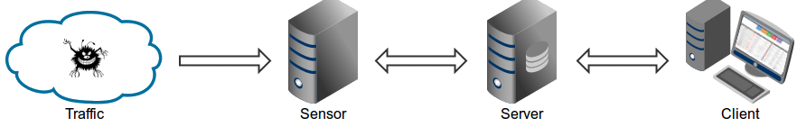
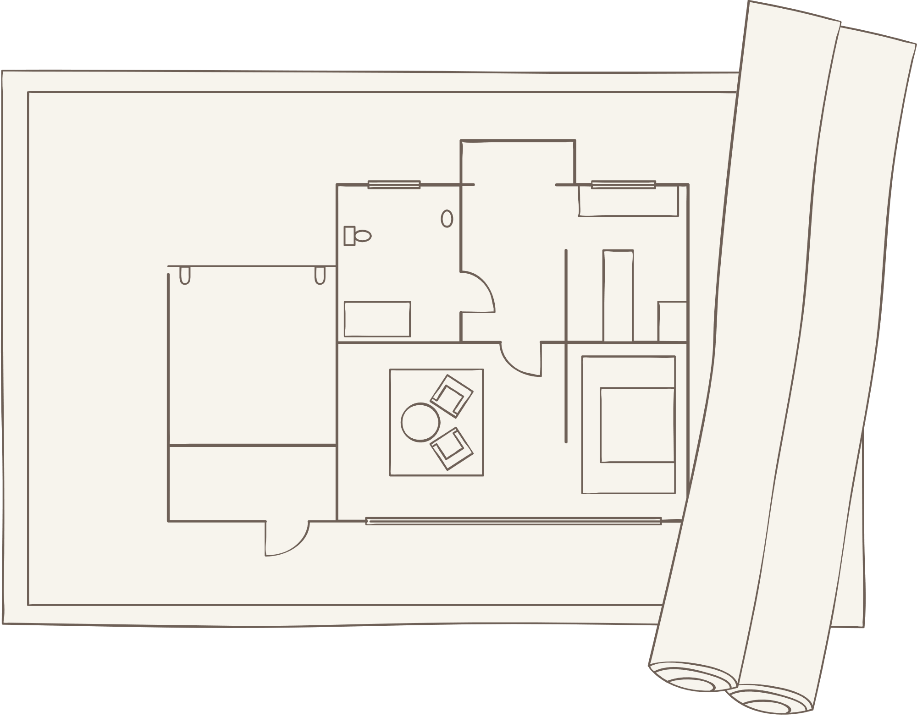
Architecture
The architecture of Systemzen is based on :-
Traffic -> Sensor <-> Server <-> Client architecture.
Sensor(s) is a standalone component running on the monitoring node (e.g. Linux platform connected passively to the SPAN/mirroring port or transparently inline on a Linux bridge) or at the standalone machine (e.g. Honeypot) where it "monitors" the passing Traffic for blacklisted items/trails (i.e. domain names, URLs and/or IPs).
In case of a positive match, it sends the event details to the (central) Server where they are being stored inside the appropriate logging directory (i.e. LOG_DIR described in the Configuration section).
If Sensor is being run on the same machine as Server (default configuration), logs are stored directly into the local logging directory. Otherwise, they are being sent via UDP messages to the remote server (i.e. LOG_SERVER described in the Configuration section).

Slide 9
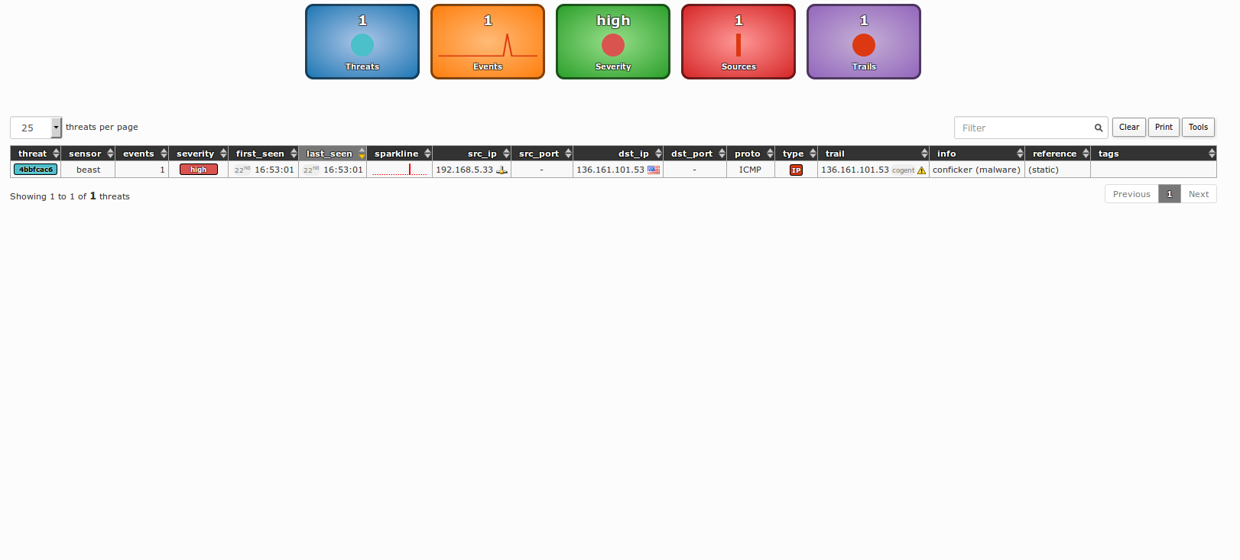
Demo Page

Slide 10
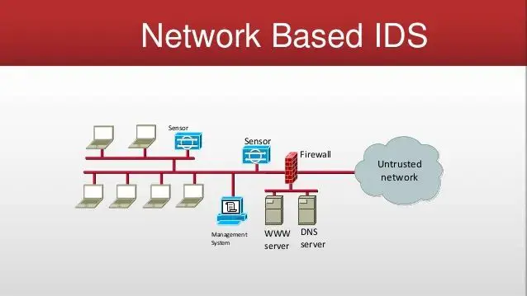
Network-Based IDS
A network-based intrusion detection system (NIDS) is a security system that monitors and analyzes network traffic for signs of malicious activity or policy violations. It is typically deployed on a network perimeter, such as at the boundary between a company’s internal network and the internet.
The purpose of a NIDS is to identify and respond to potential security incidents in real-time, before they can cause significant damage to the network or its data.
The main components of a NIDS include sensors, a central management console, and analysis engines. The sensors are responsible for capturing network traffic and sending it to the management console for analysis.
The management console is responsible for storing and analyzing the traffic data, and for generating alerts when suspicious activity is detected. The analysis engines use complex algorithms and machine learning techniques to analyze the traffic data and identify potential threats.

Slide 11

IDS Challenges
Data Collection: One of the biggest challenges of IDS projects is collecting data from various sources. The data can be in different formats, and it can be difficult to parse and analyze the data.
Algorithm Selection: Choosing the right algorithms for detecting and analyzing network traffic is crucial. IDS requires algorithms that are both fast and accurate, which can be challenging to find.
False Positives: False positives can be a significant issue in IDS projects, as they can cause unnecessary alerts and consume resources. Reducing false positives is a critical challenge in IDS projects.
Real-time Processing: IDS systems need to process network traffic in real-time, which can be a challenge for even the fastest systems. Processing speed is essential for detecting and preventing attacks before they cause significant damage.
Integration: Integrating the IDS system with other security systems, such as firewalls and antivirus software, can be challenging. This requires a thorough understanding of the existing security architecture and how the new system will fit into it.
Resources: IDS projects require significant resources, both in terms of hardware and software. Setting up a high-performance IDS system can be expensive and requires careful planning.
System Maintenance: Maintaining an IDS system is an ongoing challenge. The system must be kept up to date with the latest security patches and software updates, and any issues must be addressed promptly to ensure the system remains effective.

Slide 12

In conclusion, developing an IDS using Python, Docker, HTML, CSS, and JS was a challenging task that required a significant amount of effort, time, and technical expertise. The project involved implementing various components, including the network-based IDS, machine learning algorithms, and a web-based user interface. However, we faced some challenges, such as data preprocessing, feature selection for machine learning, and deploying the project using Docker containers. Additionally, designing and implementing the user interface with HTML, CSS, and JS also presented its own set of difficulties.
Nevertheless, the project was a great learning experience that allowed us to gain valuable knowledge and expertise in working with different technologies and developing a comprehensive IDS system. Despite the challenges, we are proud of the final result and the robustness of the IDS system. We hope that our project can serve as a helpful resource for those interested in network security and IDS system development.

Slide 13
Thank you!

